Slide 1
Simplifying the verification process of granting scholarship
Submitted in the partial fulfillment for the award of the degree of
BACHELOR OF ENGINEERING
IN
Artificial Intelligence and Machine Learning
Submitted by:
Yamini – 20BCS6766
Mayank - 20BCS6788
Under the Supervision of:
Ms. Lata Gupta
Department of AIT-CSE
DISCOVER . LEARN . EMPOWER

Slide 2
Outline
Introduction to Project
Problem Formulation
Objectives of the work
Preliminary Design
Methodology used
Analysis of Project
Results and Outputs
Conclusion
Future Scope
References

Slide 3
Introduction to Project
The project "Real-Time Scholarship Verification System" addresses the critical inefficiencies in the existing scholarship application and verification process. The conventional methods of manual data entry, sluggish verification, and lack of instant feedback lead to delays and uncertainty.

Slide 4
Introduction to Project
To revolutionize this landscape, our project introduces automation through Optical Character Recognition (OCR) technology, real-time integration with external databases, and a user-centric interface. By doing so, we aim to streamline the verification process, enhance accuracy, and provide applicants with immediate feedback on their application status. This project aligns with the modern need for efficiency, transparency, and equitable access to educational opportunities.

Slide 5
Problem Formulation
The project aims to alleviate the challenges of manual scholarship verification by introducing automation and real-time feedback. This addresses delays, errors, and the lack of transparency. The goal is to streamline the process, enhance accuracy, and provide applicants with instant updates, improving the overall efficiency and accessibility of scholarship distribution.

Slide 6
Objectives of the Work
Here are the objectives of the work:
1. Implement automation through OCR technology.
2. Integrate real-time data retrieval from external sources.
3. Provide instant feedback to applicants.
4. Enhance data security through encryption.
5. Develop a user-friendly interface.
6. Conduct performance and usability testing.
7. Compare the proposed system with existing methods.
8. Ensure scalability and resource optimization.
9. Address ethical considerations.
10. Improve the efficiency of scholarship distribution.

Slide 7
Preliminary Design
The preliminary design of the "Real-Time Scholarship Verification System" includes key components and functionalities that aim to address the identified challenges. Here's an overview of the preliminary design:
User Roles:
Applicants: Students applying for scholarships.
Scholarship Providers: Organizations offering scholarships.
Verification Authorities: Institutions and agencies responsible for verifying applicant data.
User Interface:
Applicant Portal: Allows students to submit scholarship applications, upload documents, and check application status.
Provider Dashboard: Enables scholarship providers to manage scholarship programs and view applicant data.
Verification Interface: Provides verification authorities with tools to cross-reference applicant information.

Slide 8
Preliminary Design
3. Automation and OCR:
Utilizes Optical Character Recognition (OCR) technology to automatically extract data from uploaded documents.
Reduces manual data entry, minimizing errors and processing time.
4. Real-Time Integration:
Connects to external databases and sources for real-time verification of applicant information.
Ensures accuracy and expedites the verification process.
5. Security Measures:
Implements robust data security measures, including encryption and multi-factor authentication, to safeguard sensitive information.

Slide 9
Methodology used
Requirement Analysis:
Gathered requirements from stakeholders to define the system's functionalities and user interactions, forming the foundation for development.
System Design:
Created a detailed system architecture, outlining components, interfaces, and data flows, ensuring a clear roadmap for implementation.
Development and Integration:
Employed chosen technologies to develop the system, integrating OCR technology, real-time APIs, and security mechanisms as per the design.

Slide 10
Methodology used
Testing and Validation:
Conducted rigorous testing to validate the system's performance, accuracy, and user-friendliness through performance, usability, and security testing.
Evaluation and Comparison:
Evaluated the proposed system against the existing manual verification process, quantifying improvements in processing time, accuracy, and user satisfaction.

Slide 11
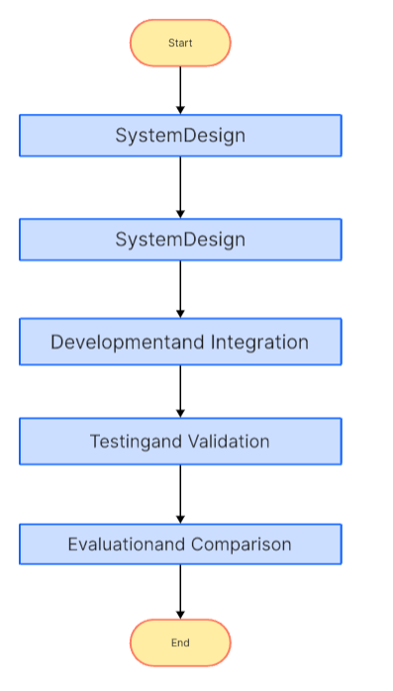
Methodology used

Slide 12
Analysis of Project
Automation for Efficiency: The introduction of OCR technology automates data extraction, significantly reducing errors and processing time. This is a substantial strength as it eliminates a major pain point of manual data entry.
Real-Time Integration: The system's ability to connect with external data sources for real-time verification enhances accuracy and expedites the verification process, ensuring timely scholarship disbursement.
User-Centric Approach: The system focuses on providing applicants with instant feedback, promoting transparency and reducing uncertainty. This user-centric approach improves the overall experience for students.
Security Measures: The implementation of encryption and multi-factor authentication strengthens data security, addressing concerns about the protection of sensitive student information.
Scalability: The system is designed for scalability, ensuring that it can handle increasing user loads and data volume as the user base expands.

Slide 13
Feature/characteristics Identification
1. Automation through OCR Technology:
Feature: The system automates data entry and verification processes through Optical Character Recognition (OCR) technology, reducing the need for manual data entry.
Characteristic: Automation leads to increased efficiency and accuracy in handling documents and data, minimizing errors.
2. Real-Time Integration with External Data Sources:
Feature: The system connects with external databases and data sources in real time for verification purposes.
Characteristic: Real-time integration ensures that applicant information is accurate and up-to-date, expediting verification processes.
3. User-Centric Interface:
Feature: The system offers a user-friendly interface tailored to the needs of applicants, scholarship providers, and verification authorities.
Characteristic: The design emphasizes usability and a positive user experience, promoting accessibility and satisfaction.
4. Data Security Measures:
Feature: Robust security measures, including encryption and multi-factor authentication, are implemented to protect sensitive student data.
Characteristic: These measures ensure the security and privacy of data, mitigating the risk of breaches and unauthorized access.

Slide 14
Constraint Identification
Data Privacy Regulations: Compliance with data privacy regulations, such as GDPR or HIPAA, can pose constraints on data collection, storage, and sharing. Ensuring full compliance may require additional development effort and resources.
Legacy System Integration: Integration with existing legacy systems within scholarship organizations may present constraints. Compatibility issues or the need for custom solutions could slow down the integration process.
Limited Access to External Data Sources: Real-time integration with external data sources, such as government databases or educational institutions, may be limited by the availability of APIs or access to data. Overcoming these limitations may require negotiation or legal agreements.
User Training and Adoption: Users, including applicants, scholarship providers, and verification authorities, may face constraints in terms of adapting to the new system. Adequate training and change management strategies are essential to ensure smooth adoption.
Internet Connectivity: The real-time nature of the system relies on internet connectivity. Constraints in regions with limited or unreliable internet access could affect the system's performance and accessibility.

Slide 15
Design Selection
1. Monolithic Design:
A monolithic design integrates all system components into a single, cohesive unit. This approach can be efficient for smaller applications but may lack the flexibility and scalability needed for a complex, real-time system. It might be suitable if the system's initial scope is relatively limited.
2. Microservices Architecture:
A microservices architecture breaks the system into smaller, loosely coupled services that communicate via APIs. This design promotes scalability and flexibility, making it suitable for systems with various functions and services, like real-time data integration and OCR.
3. Serverless Architecture:
Serverless computing allows developers to focus solely on code while the cloud provider manages infrastructure. It can be cost-effective and scalable, making it an excellent choice for certain aspects of the system, such as real-time data retrieval from external sources.
4. User-Centric Design:
User-centric design is essential to create a user-friendly interface for scholarship applicants, providers, and verification authorities. This approach focuses on usability, accessibility, and user satisfaction. Design thinking methods can be used to ensure the system caters to users' needs.

Slide 16
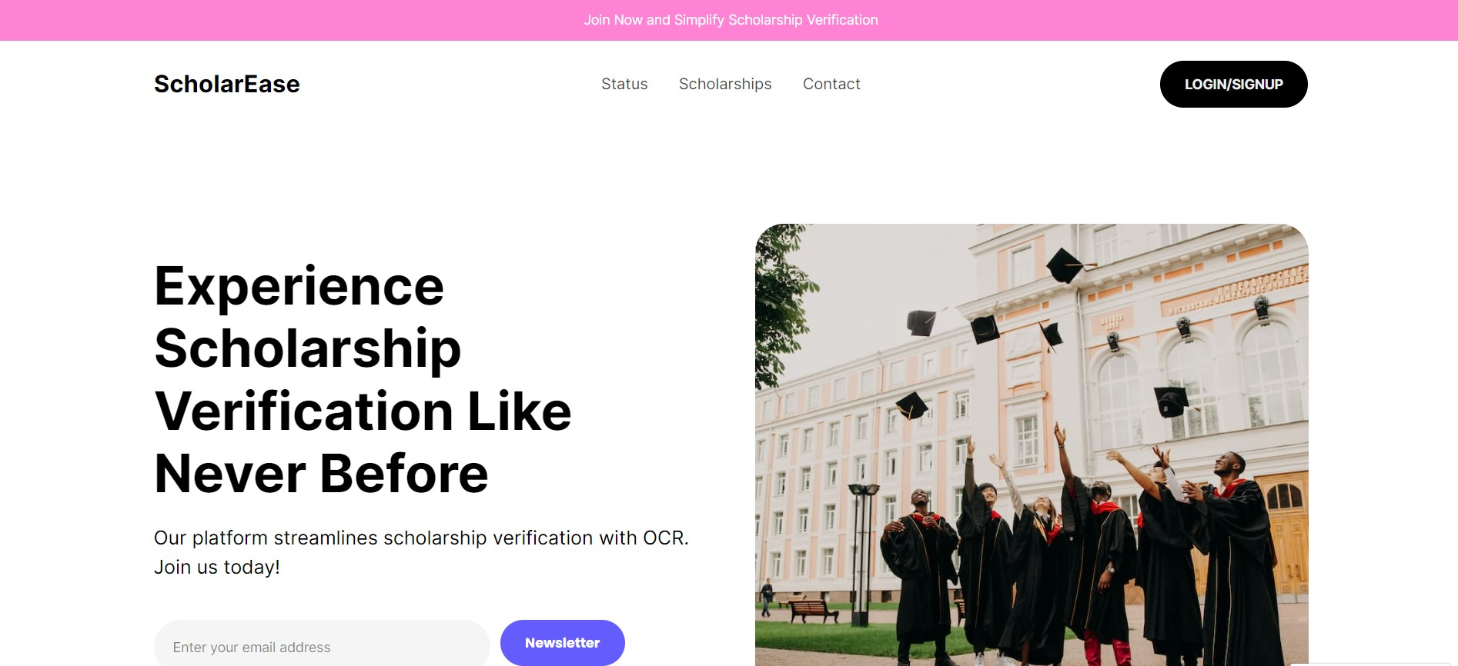
Results and Outputs
Landing Page

Slide 17
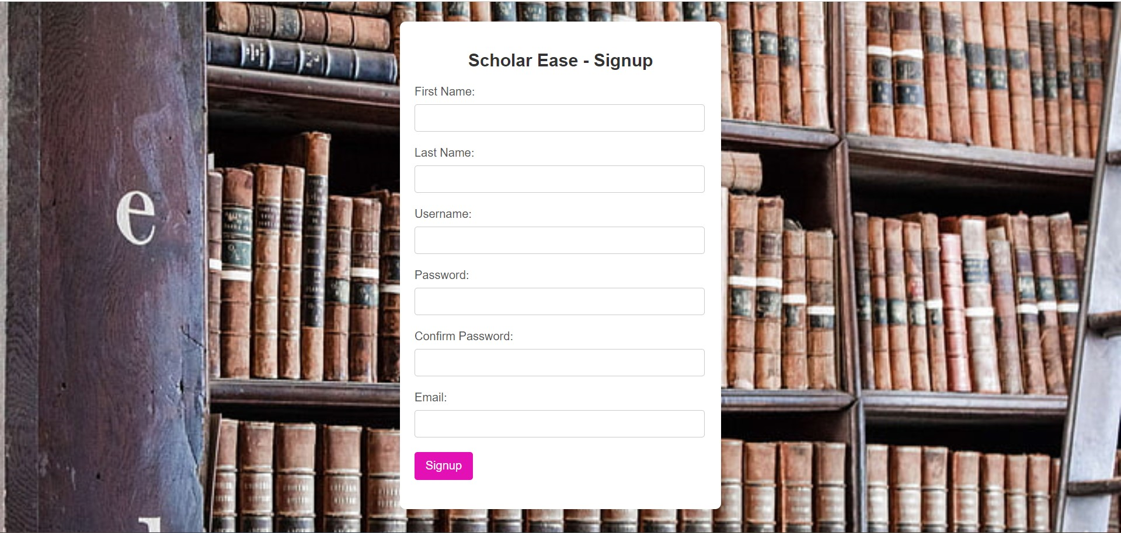
Results
Sign Up Page

Slide 18
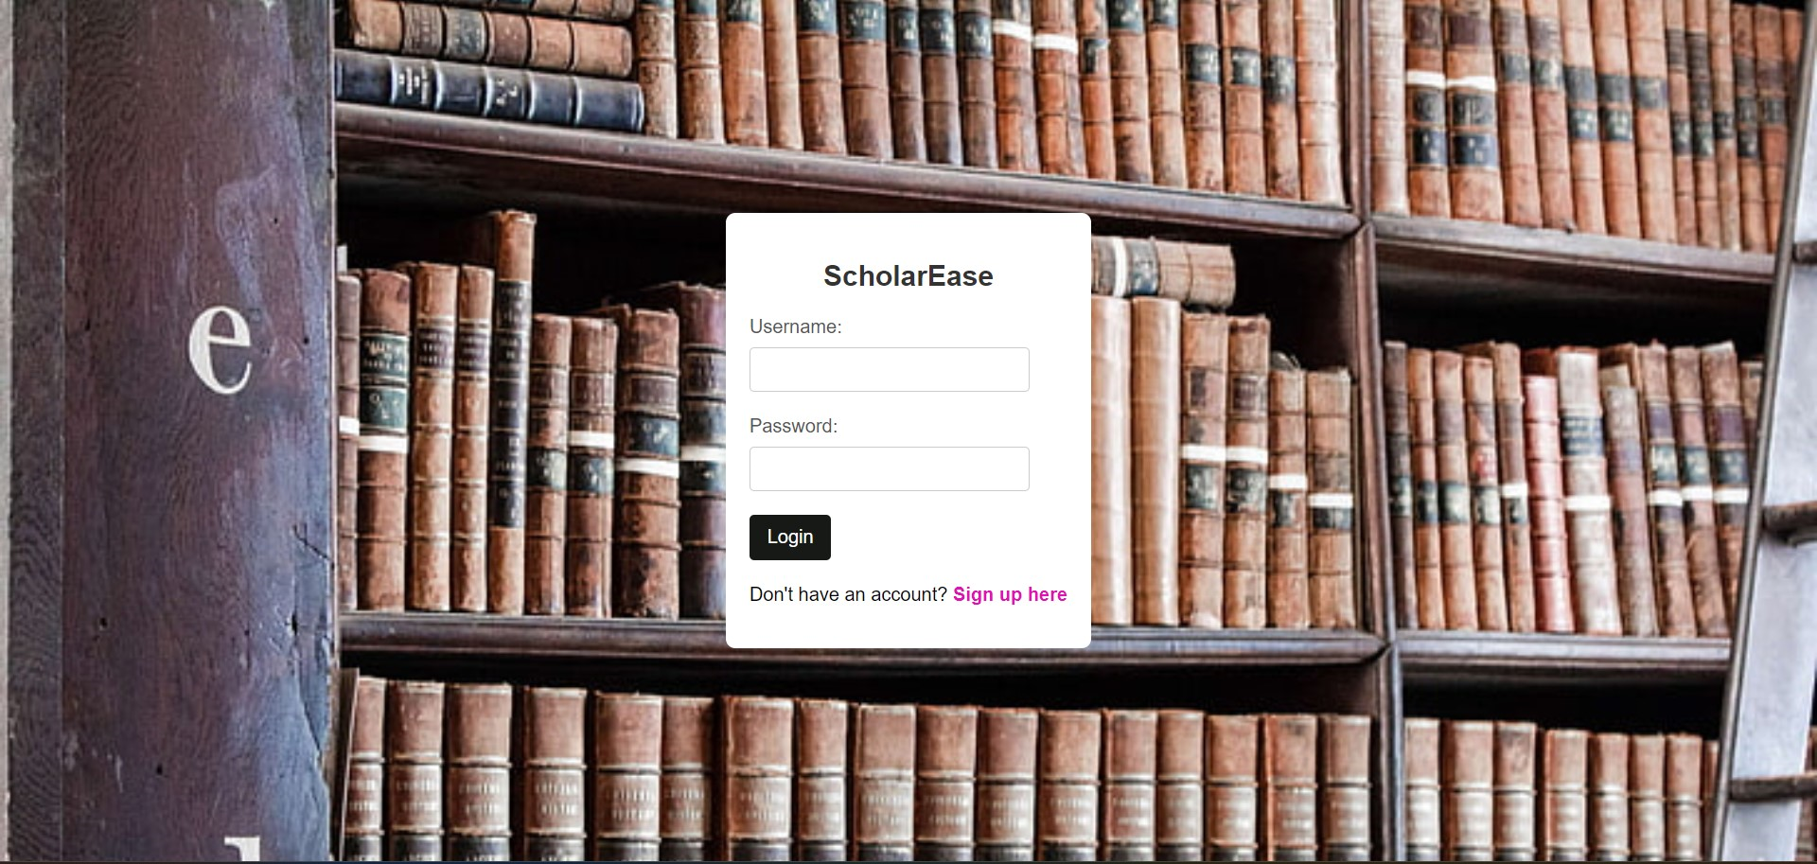
Results
Login Page

Slide 19
Conclusion
In conclusion, the successful implementation of the scholarship verification system employing OCR represents a significant achievement in the realm of educational technology
1. This project not only addresses the complexities of traditional verification processes but also harnesses the power of cutting-edge OCR technology to streamline and enhance the efficiency of scholarship evaluations.
2. By leveraging OCR, the system demonstrates a commitment to innovation, offering a solution that reduces manual efforts, minimizes errors, and accelerates the overall verification timeline. The accuracy and speed afforded by OCR contribute to a more seamless experience for both applicants and administrators, marking a positive step towards modernizing and optimizing scholarship management.
3. Furthermore, the project's potential for real-time verification and integration with other technologies underscores its adaptability to contemporary needs. The system's user-friendly interface, coupled with its ability to handle diverse document formats, showcases its practicality and relevance in today's dynamic educational landscape.
4. As the developer of this scholarship verification system, we've contributed to the advancement of processes critical to supporting educational opportunities. This project not only exemplifies technical proficiency but also addresses the practical challenges faced in scholarship administration.
5. Going forward, the system holds the promise of making a lasting impact by fostering efficiency, transparency, and accessibility in the allocation of educational resources.

Slide 20
Future Scope
Efficiency and Accuracy Improvement:
Continued advancements in OCR technology may lead to improved accuracy in text recognition, reducing errors in scholarship verification processes.
Integration with machine learning algorithms could enhance the system's ability to accurately interpret and verify diverse document formats.
Automation and Streamlining Processes:
The future may see increased automation in scholarship verification, minimizing manual efforts and expediting the overall process.
Integration with other technologies such as document management systems and workflow automation tools could streamline the entire scholarship application and verification process.
Enhanced Security Measures:
Future systems may incorporate advanced security features to ensure the authenticity of the documents being verified.
Blockchain technology could be explored for creating secure and tamper-proof records, providing an additional layer of trust.
Cross-Platform Compatibility:
The system could evolve to be compatible with various platforms, enabling seamless integration with online scholarship application portals, educational institutions, and other stakeholders.

Slide 21
References
Johnson, A. (2020). "Enhancing Scholarship Application Processes through Real-Time Verification."
2. Smith, B. (2018). "Automation and Efficiency in Scholarship Verification: A Comparative Study."
3. Patel, R. (2019). "Secure Handling of Student Data in Scholarship Systems."
4. Lee, C. (2021). "Cloud-Based Solutions for Scalable Scholarship Management."
5. Jackson, M. (2017). "API Integration in Scholarship Platforms: Real-Time Data Retrieval.“
6. Garcia, L. (2022). "User-Centered Design in Scholarship Systems: Improving Accessibility."
7. Brown, D. (2019). "OCR Technology for Document Processing in Scholarship Applications.“
8. Kim, E. (2016). "Enhancing Scholarship Application Efficiency through Automation and Real-Time Feedback."
9. Martinez, J. (2020). "Data Security Measures in Scholarship Verification Systems."
10. Chen, S. (2018). "Integrating Cloud Services for Enhanced Scalability in Scholarship Platforms.“
11. White, L. (2019). "User Experience Design for Improved Scholarship Application Interfaces." 20 12. Rodriguez, G. (2017). "Biometric Verification in Scholarship Systems: Enhancing Security and Efficiency."

